Slide 1
Week 5: Internal Control Quality
Dr Zheng Wang
AC8900
Semester A 2026/2027

Slide 2
Internal Control Weakness
The U.S. Congress passed the Sarbanes-Oxley Act (SOX) in July 2002. Section 404 of SOX (SOX 404) requires company management to assess the effectiveness of internal controls over financial reporting and to provide periodic auditor-attested evaluations of internal control effectiveness.
The major rationale behind this requirement is that lack of adequate internal controls leads to poor financial reporting and increases information risk, which in turn increases the cost of external financing (e.g., U.S. House of Representatives 2005).

Slide 3
Researches on Internal Control Weakness
Direct effect on financial reporting quality:
  e.g. accrual quality (Doyle, J. T., W. Ge, and S. McVay. 2007a); conservatism (e.g., Goh, B. W., and D. Li. 2011).
Direct effect on auditing:
  Audit delay (Ettredge, M., C. Li and L. Sun. 2006)
  Audit effort and pricing (Hogan, C., and M. Wilkins. 2008; Hoitash, R., U. Hoitash, and J. Bedard. 2008).
Direct effect on CFO compensation (Hoitash, R., Hoitash, U., Johnstone, K. M. 2012);

Slide 4
Researches on Internal Control Weakness
Internal control weakness is auditor-attested evaluations of material weakness in internal control, a direct signal of a low-quality financial reporting system or even integrity.
Cost of capital: equity and debt
  Cost of Equity: Ogneva, M., K. R. Subramanyam, and K. Raghunandan. 2007
  Cost of debt: Kim, Song and Zhang (2011); Costello, A. M., and R. Wittenberg-Moerman (2011)
Rent extraction:
  insider trading (Skaife, H. A., D. Veenman, and D. Wangerin. 2013 ); value of cash holdings (Gao and Jia 2015).

Slide 5
Researches on Internal Control Weakness
ICW disclosures reflect the quality of a firm’s entire information production system including the quality of both inside and publicly reported accounting information.
  Management forecasts (Feng, M., C. Li, and S. McVay. 2009); Internal capital allocation (D’Mello, R., Gao, X., and Jia, Y. 2017); Acquisition (Barnes, B., and Harp, N. 2018); Tax avoidance (Gallemore and Labro 2015).
Remediation:
  Accrual quality (Ashbaugh-Skaife, H., D. W. Collins, W. R. Kinney Jr, and R. LaFond. 2008)
  Investment efficiency (Cheng, M., D. Dhaliwal, and Y. Zhang. 2013).
  Hiring (Janet Gao; Kenneth Merkley; Joseph Pacelli; Joseph H. Schroeder. 2023).

Slide 6
Cheng et al. (2013)
An ICW suggests that there is an information problem in the firm's financial reporting system. Given this information problem and the findings from Biddle et al. (2009), we predict that firms that disclose ICWs (ICW firms) exhibit inefficient investment behavior prior to the disclosure.
More importantly, because an ICW provides an adverse public signal, these firms are expected to address their past financial reporting problems subsequent to the disclosure. Thus, firms should show an increase in the quality of their financial reporting from the pre-disclosure period to the post-disclosure period. If the improvement in the quality of financial reporting increases investment efficiency, we predict that the pre-disclosure inefficiency in investment by the ICW firms will be mitigated or eliminated in the post-disclosure period.

Slide 7
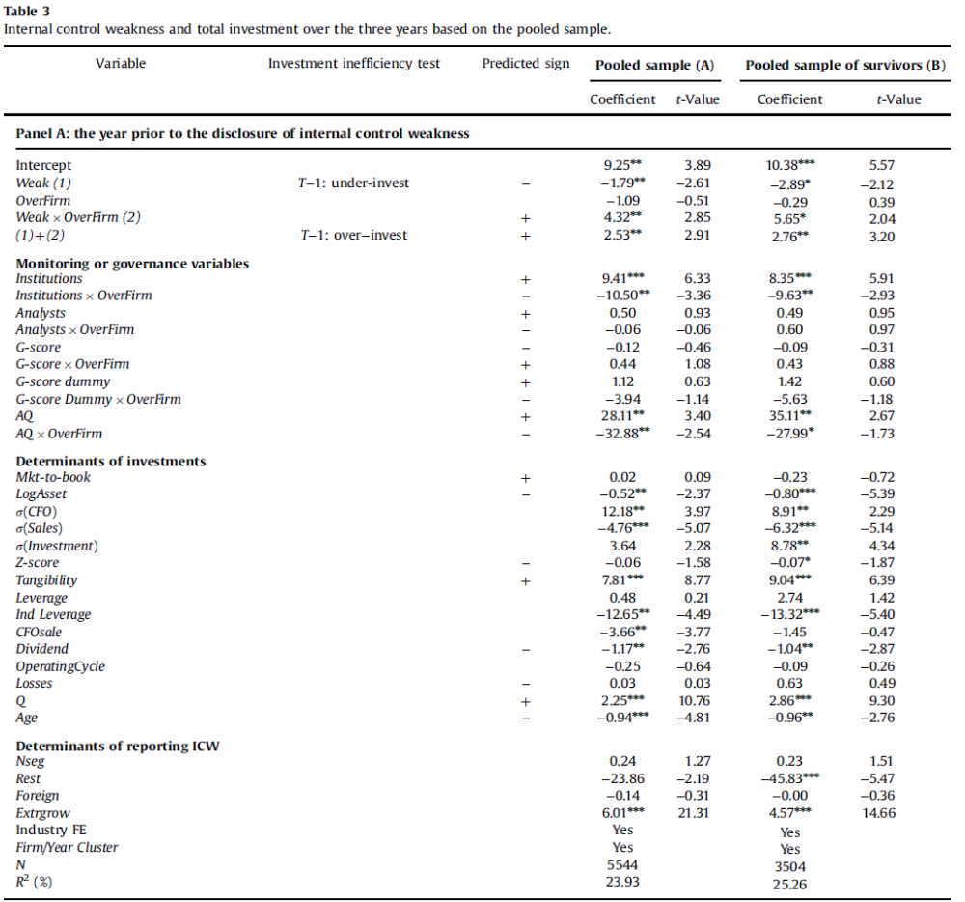

Slide 8
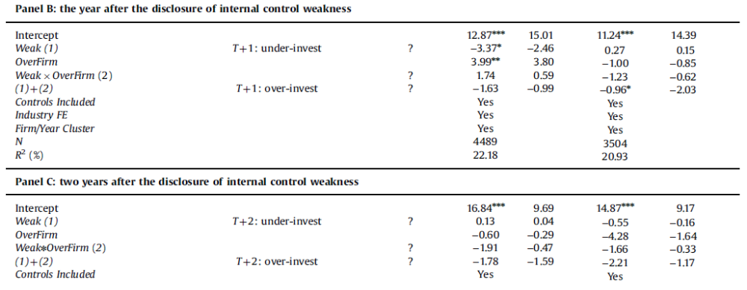

Slide 9
Kim, Song and Zhang (2011)
Abstract: Using a sample of borrowing firms that disclosed internal control weaknesses (ICW) under Section 404 of the Sarbanes-Oxley Act, this study compares various features of loan contracts between firms with ICW and those without ICW. Our results show the following. First, the loan spread is higher for ICW firms than for non-ICW firms by about 28 basis points, after controlling for other known determinants of loan contract terms. Second, firms with more severe, company-level ICW pay significantly higher loan rates than those with less severe, account-level ICW. Third, lenders impose tighter nonprice terms on firms with ICW than on those without ICW. Fourth, fewer lenders are attracted to loan contracts involving firms with ICW. Finally, our within-firm analyses show that banks increase loan rates charged to ICW firms after their disclosure of internal control problems and that banks reduce loan rates after firms remediate previously reported ICW.

Slide 10
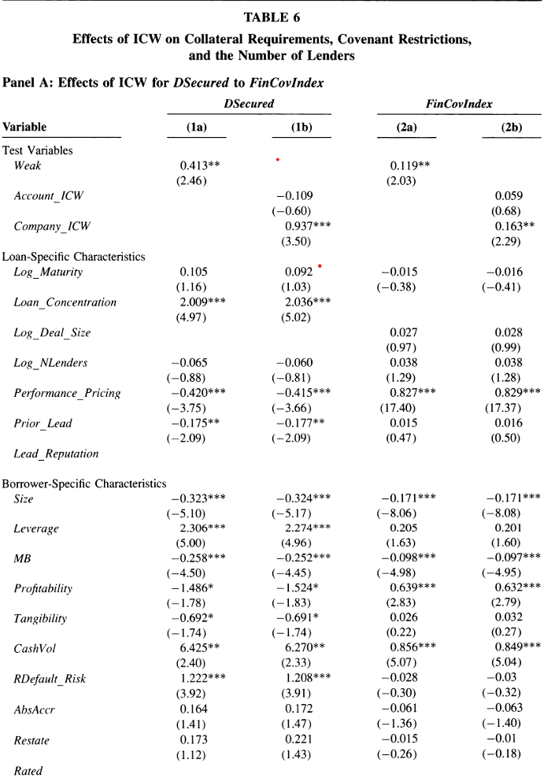

Slide 11
Shroff (2020)
This paper examines the effect of the Public Company Accounting Oversight Board (PCAOB) international inspection program on companies' financing and investing decisions. Difference-in-differences regression estimates suggest that companies respond to their auditor receiving a “deficiency-free” inspection report by issuing additional external capital amounting to 1.4 percent of assets and increasing investment by 0.5 percent of assets. These effects are larger for (1) financially constrained companies and (2) companies located in countries where there is no regulator or the regulator does not conduct inspections. Further, the effect on financing decisions is stronger in countries with (1) low corruption, (2) strong rule of law, and (3) high regulatory quality. Descriptive evidence suggests that inspections increase the use of financial covenants in debt contracts, which is likely one of the mechanisms through which inspections generate real effects. This paper documents the value of PCAOB inspections in mitigating financing frictions for non-U.S. companies.

Slide 12
Robin, Wu, and Zhang (2016)
This study examines the impact of auditor quality on financial covenants in debt contracts. We conjecture that high-quality auditors have two related effects on these debt covenants: (i) they encourage fewer and less restrictive covenants by providing assurance to lenders at contract inception and, consequently, (ii) they ensure a lower probability of eventual covenant violations. Consistent with the conjectures, we find that auditor quality is negatively associated with the intensity and tightness of financial covenants. Specifically, high-quality auditors are associated with fewer covenants (especially performance covenants) and less binding covenants. Additionally, we find that auditor quality is negatively associated with the likelihood of covenant violations. In an ancillary test, we provide evidence that high-quality auditors mitigate the detrimental effect of covenant violations on the cost of borrowing. Together, these findings highlight the important role of auditors in debt contracting.

Slide 13
Week 5 Homework: Internal control quality and conservatism: positive or negative relationship

